Slide 1
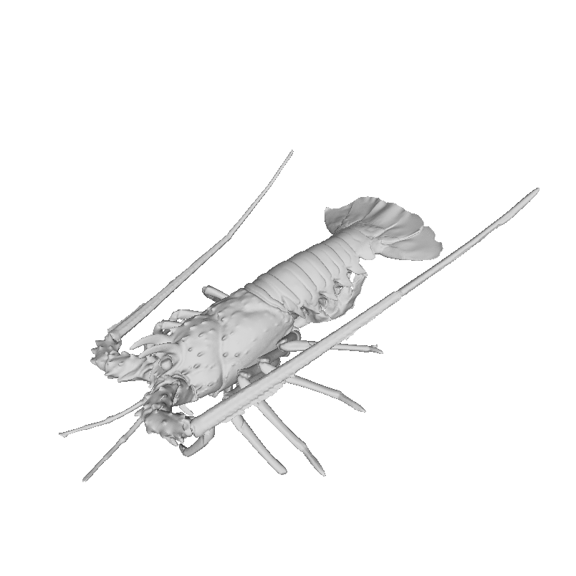
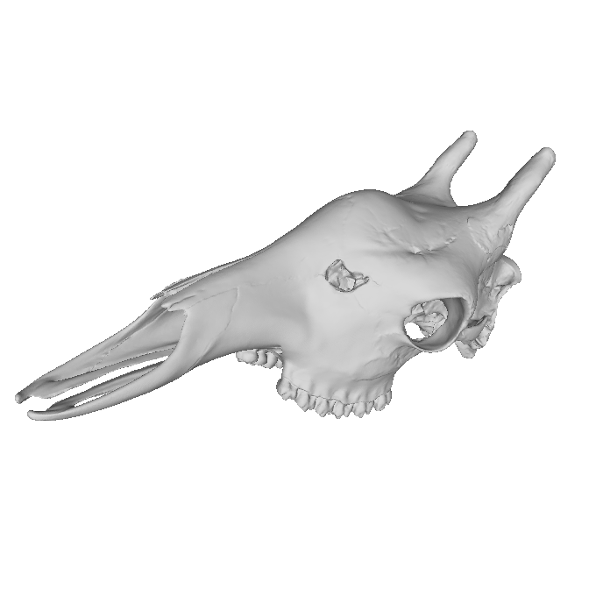
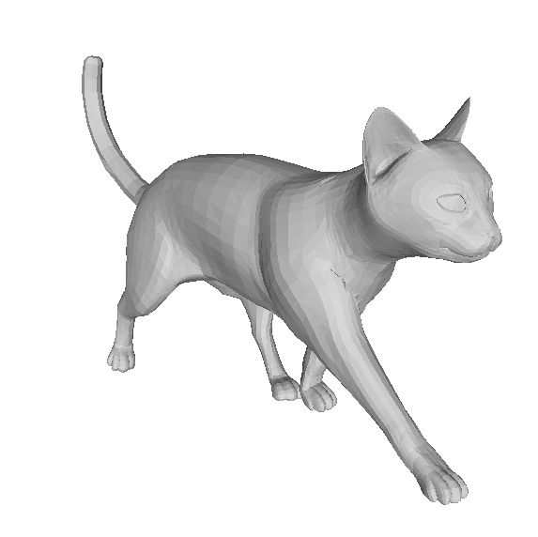
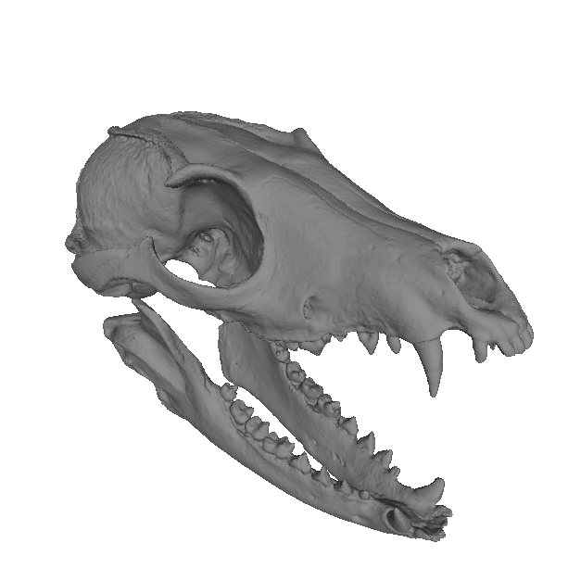
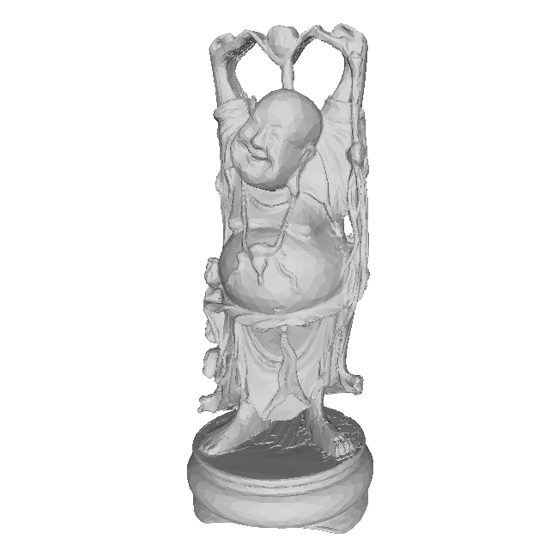
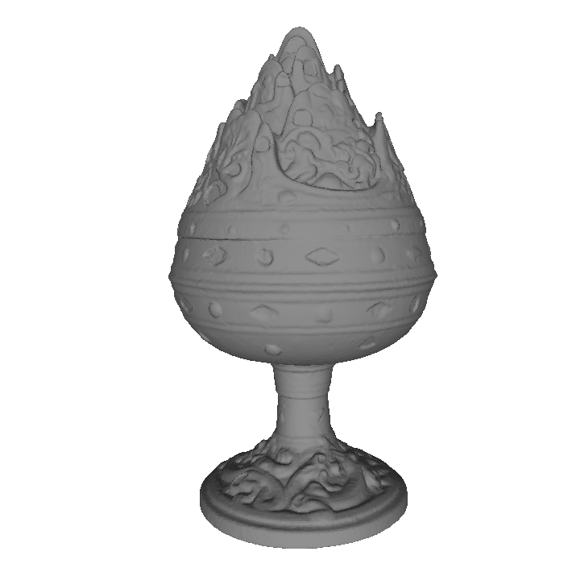
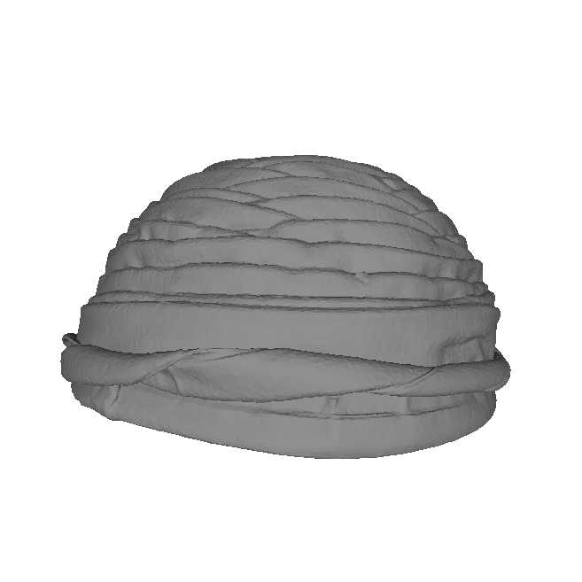
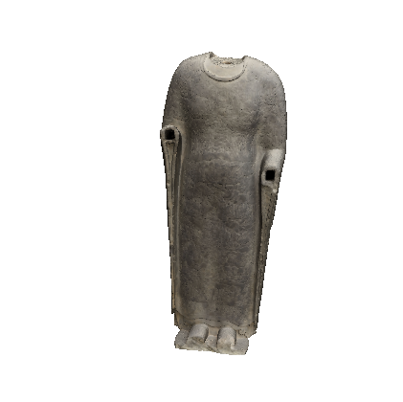
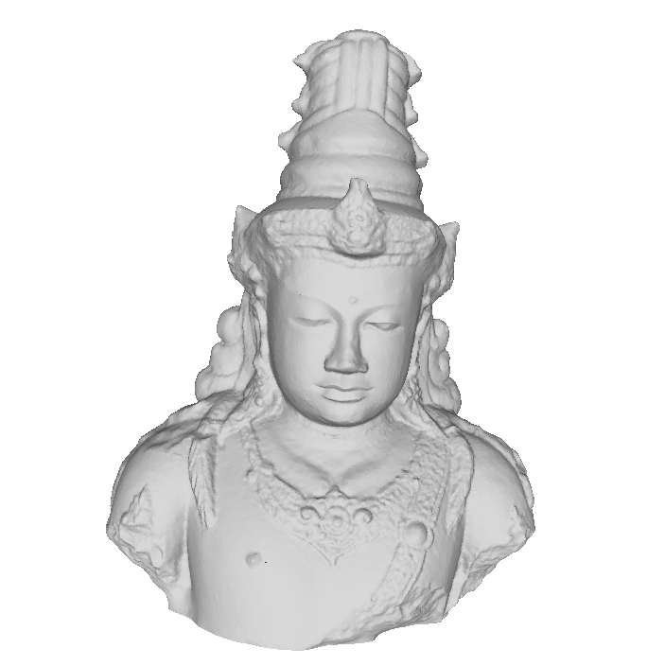
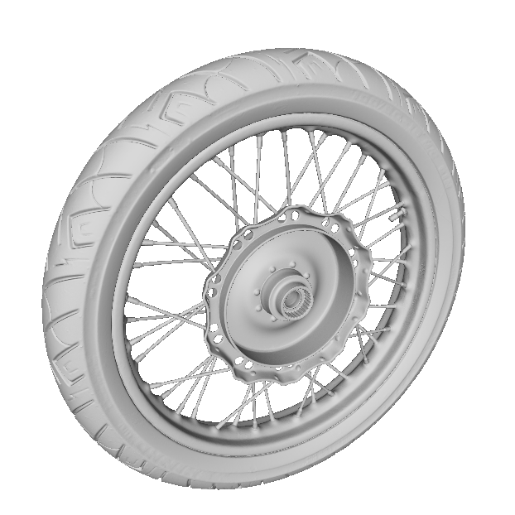
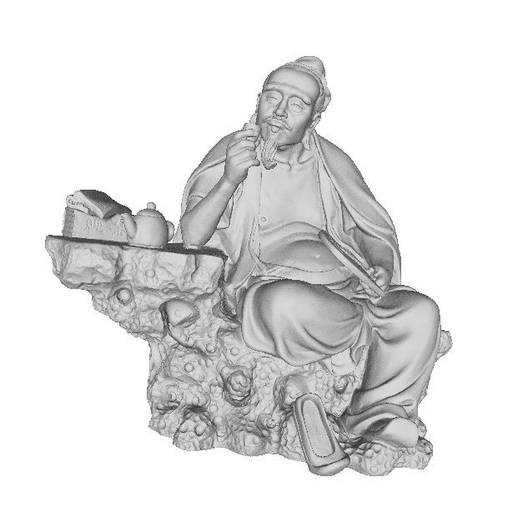
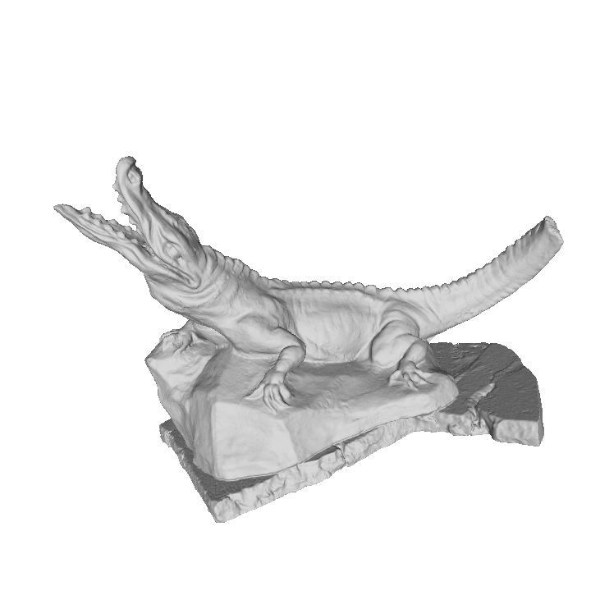
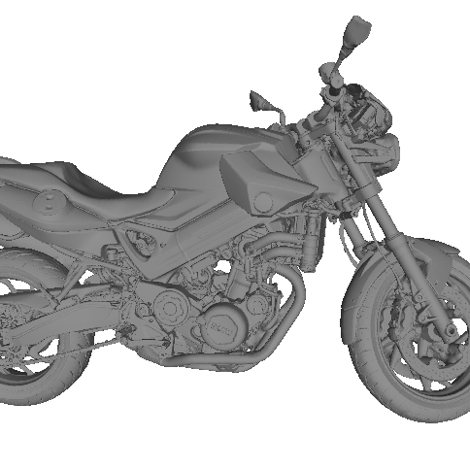
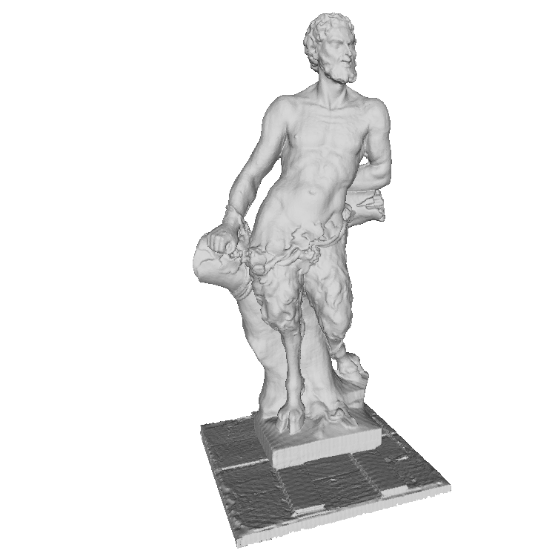
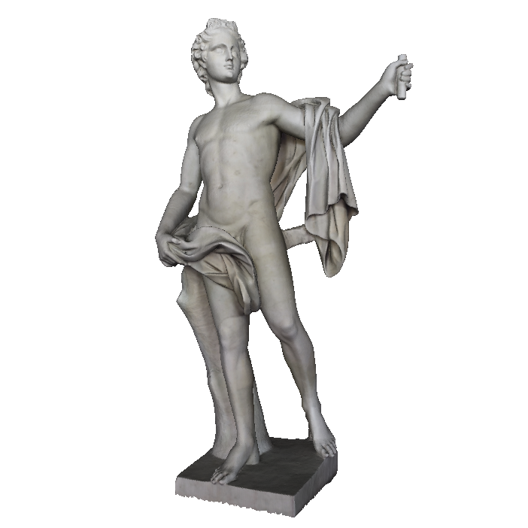
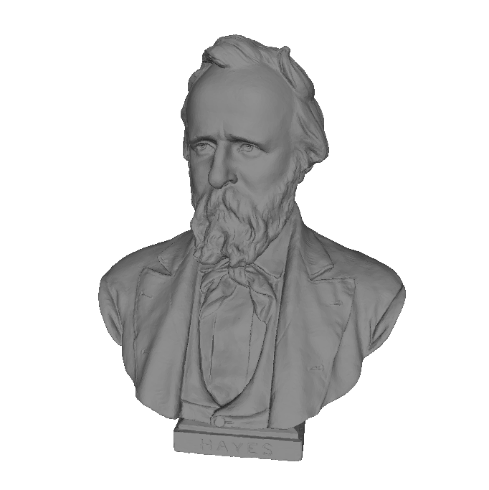
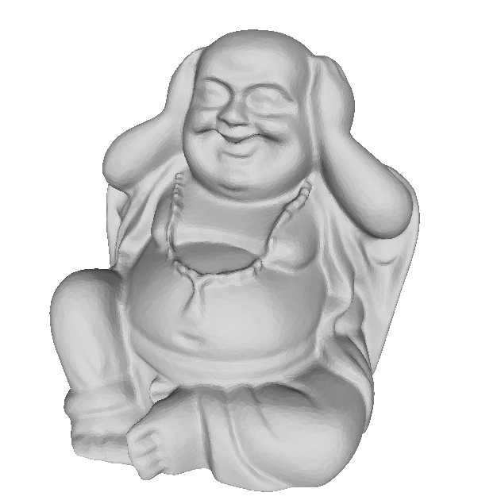
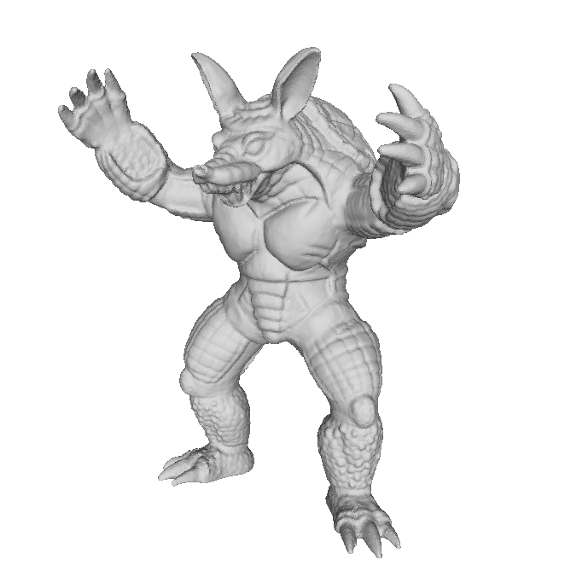
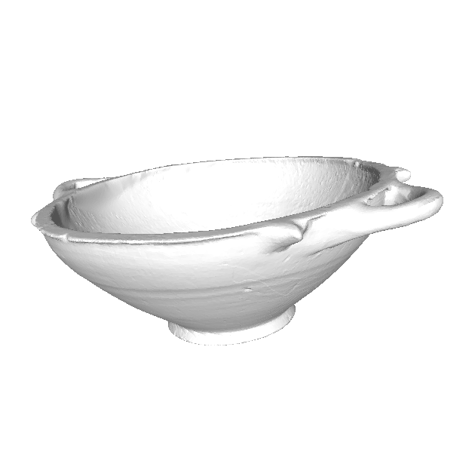
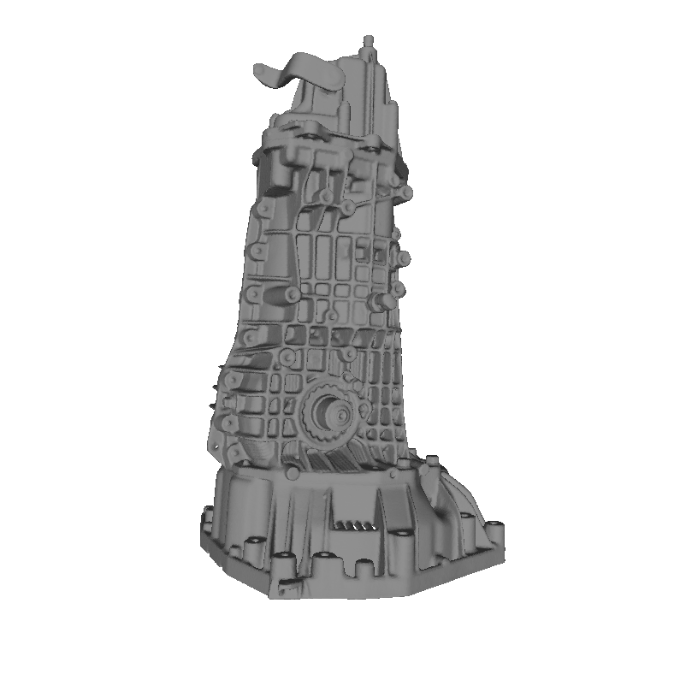
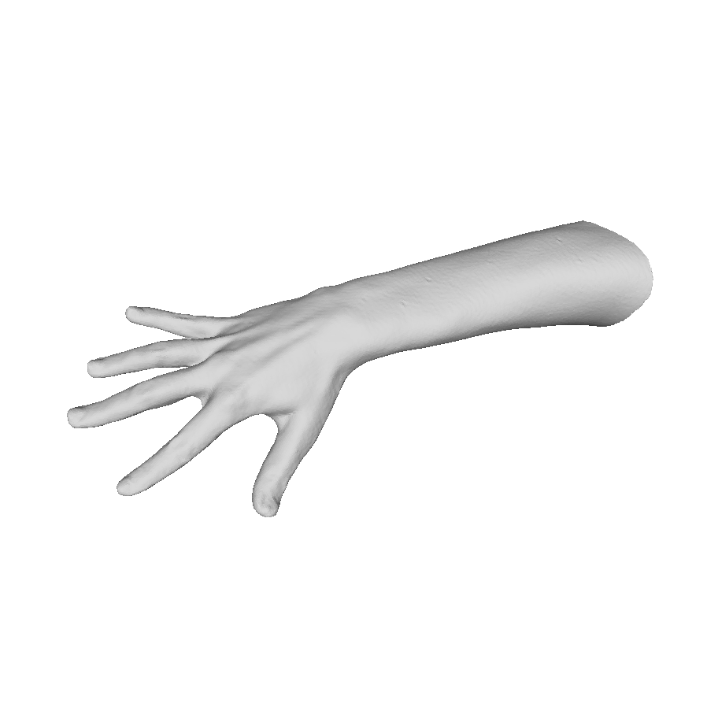
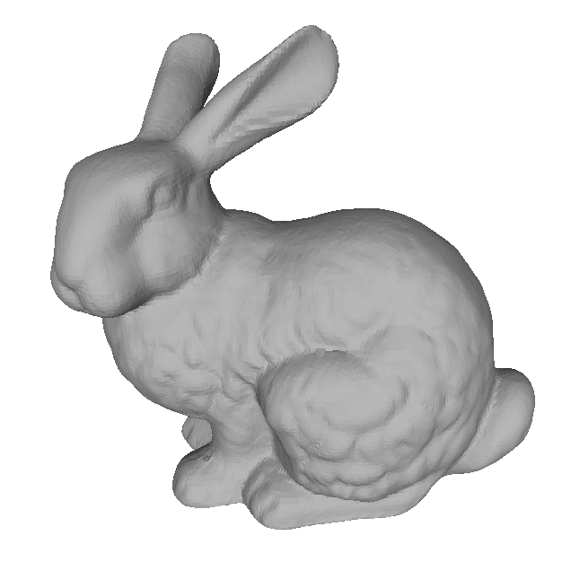
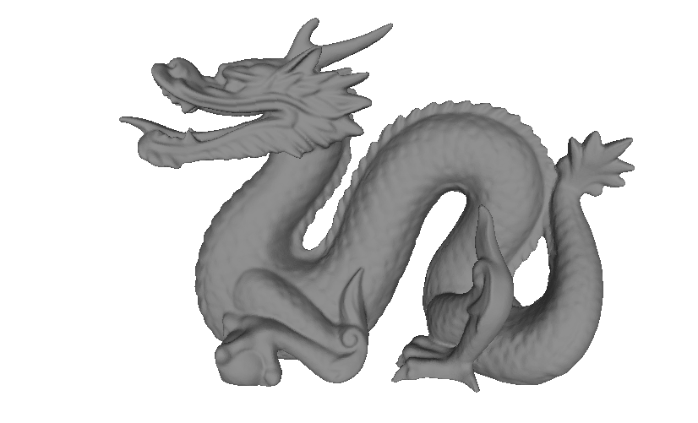
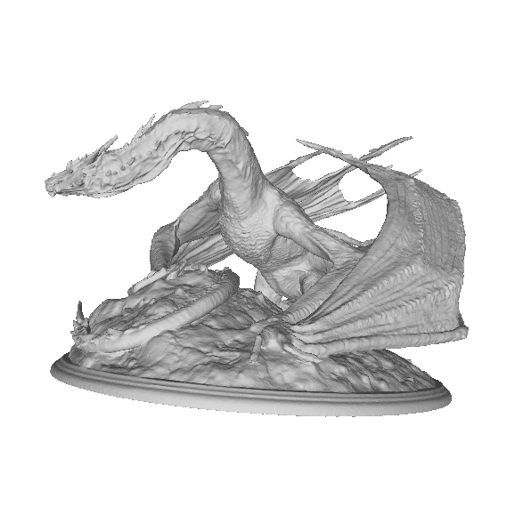
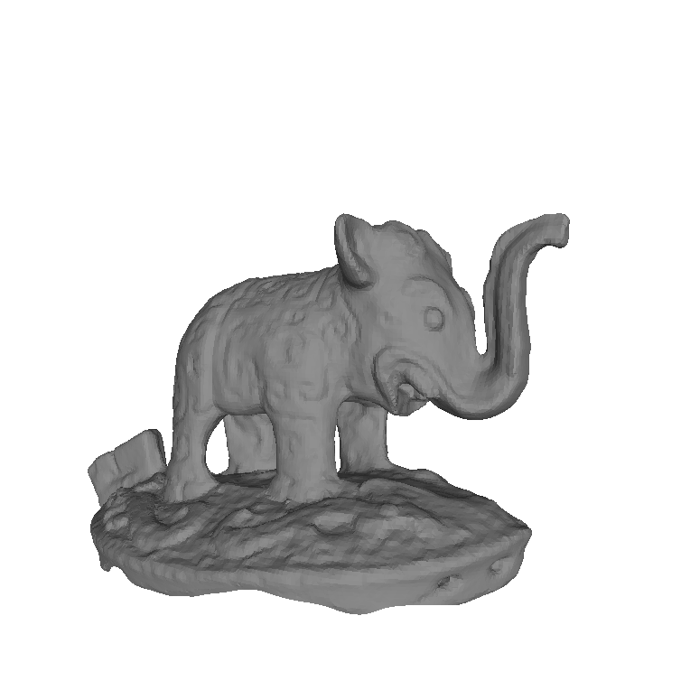
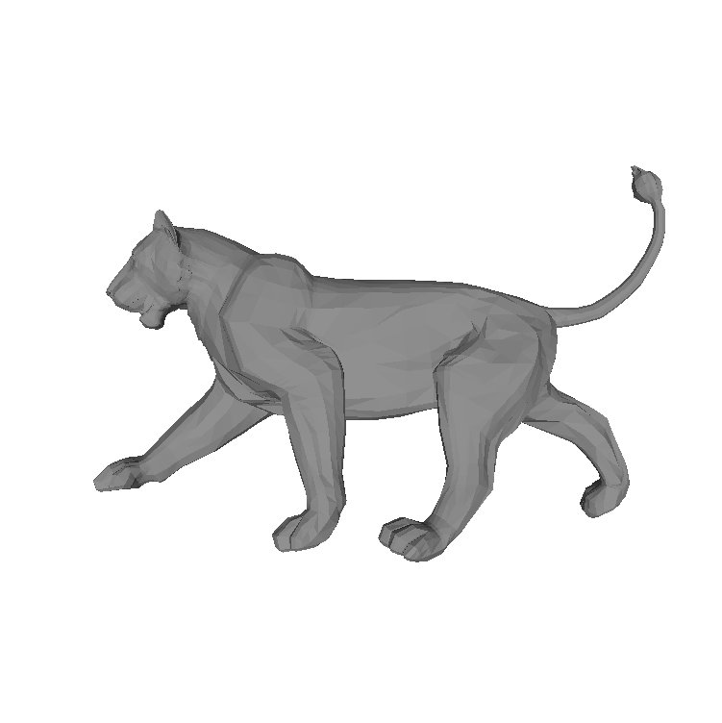
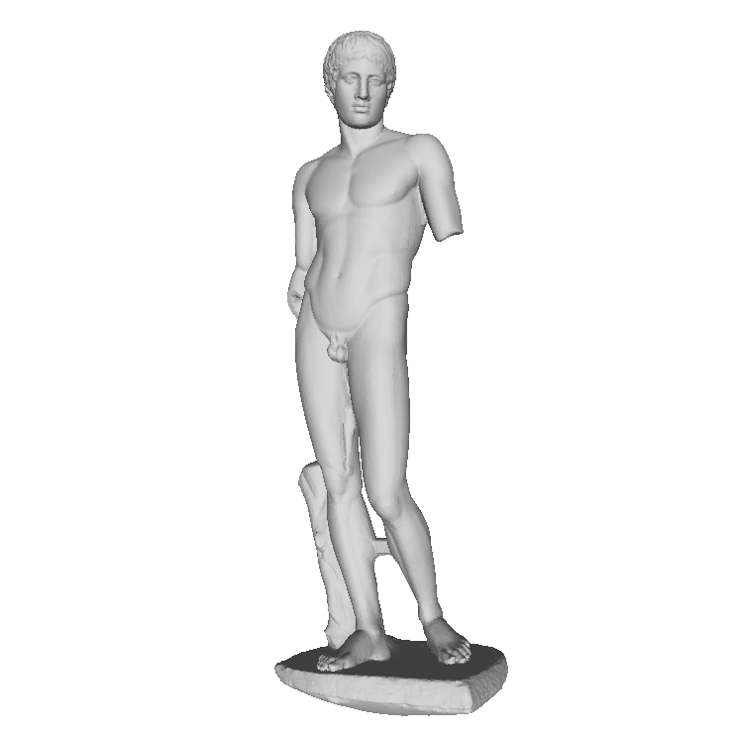
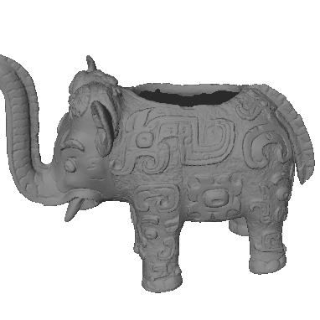
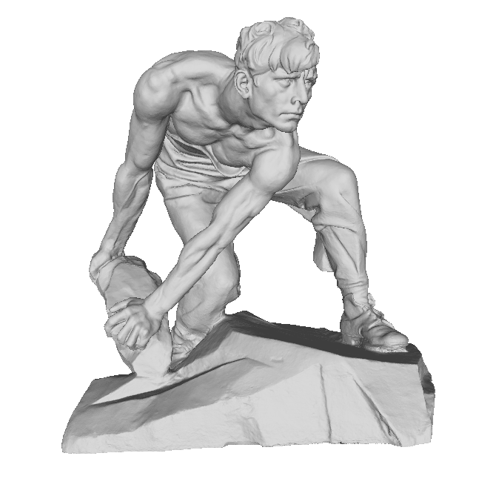
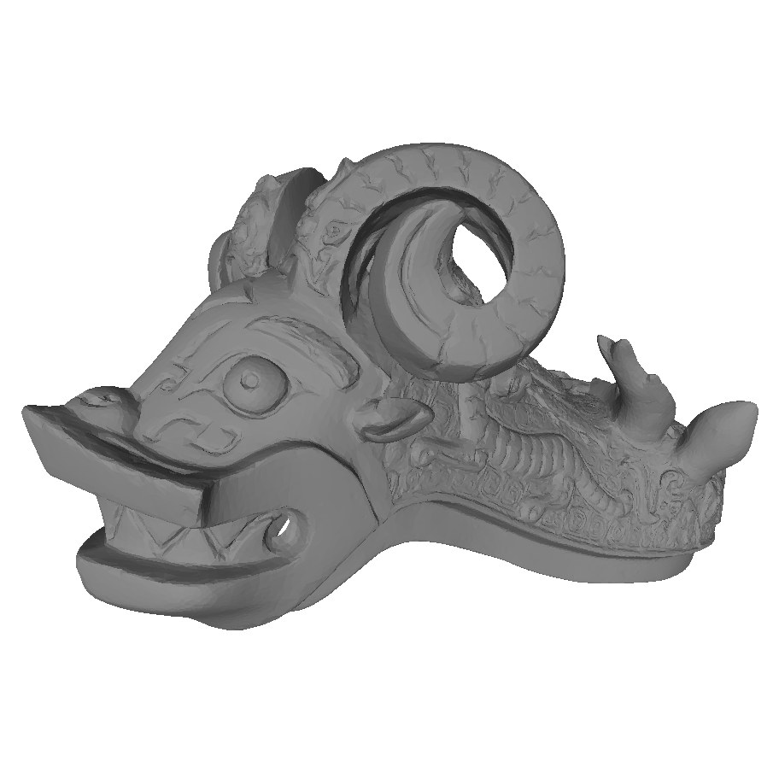
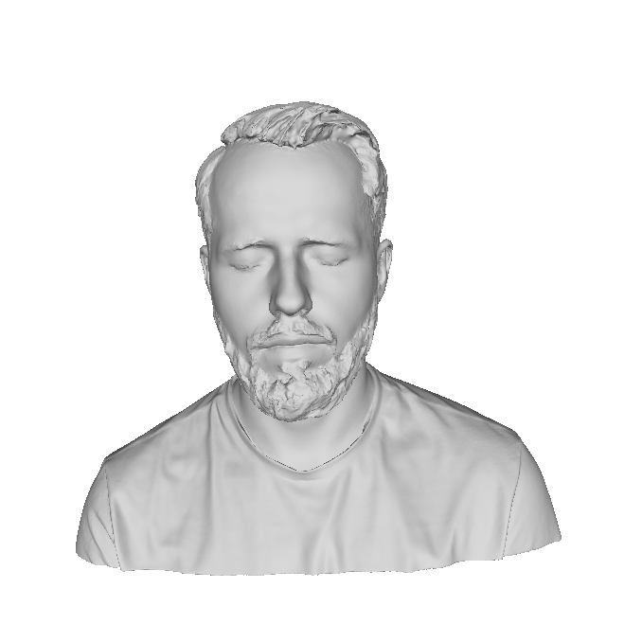
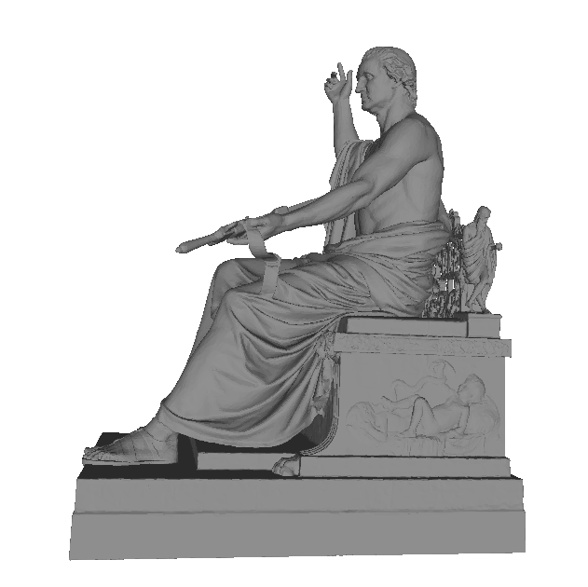
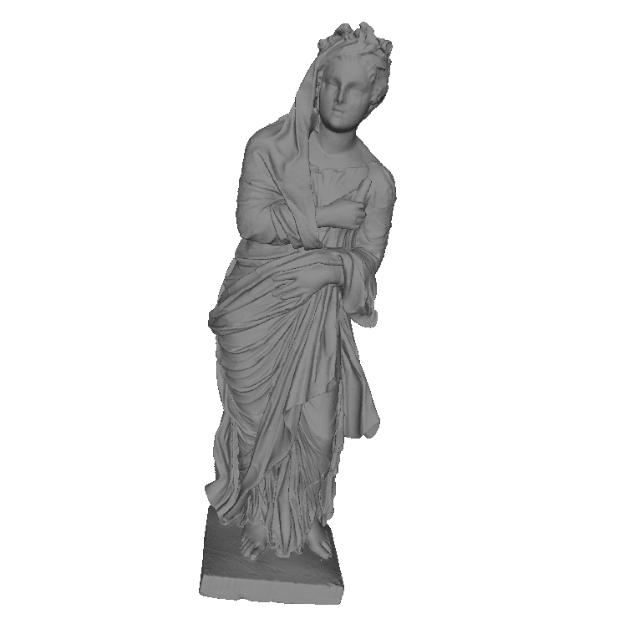
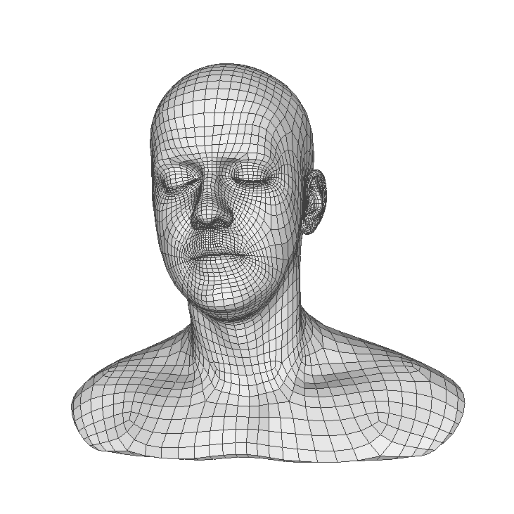
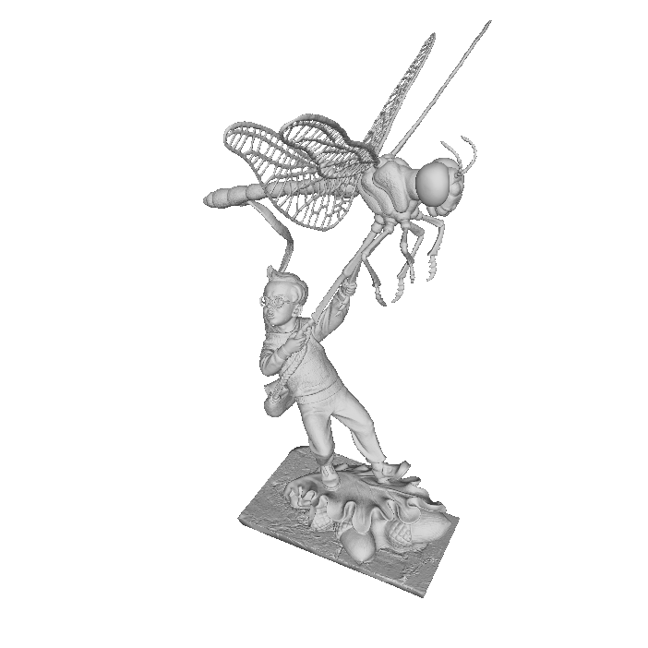
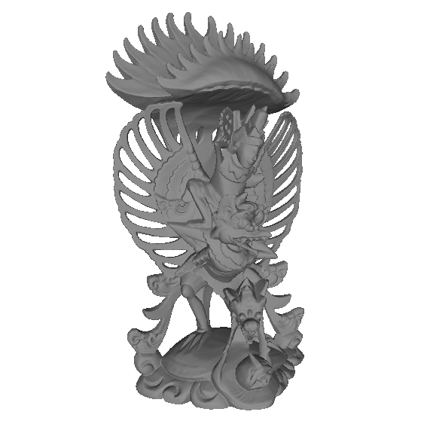
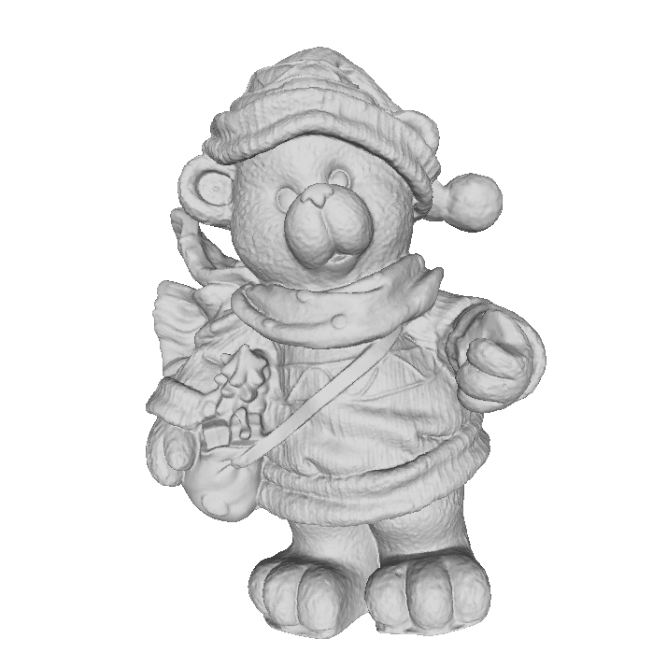
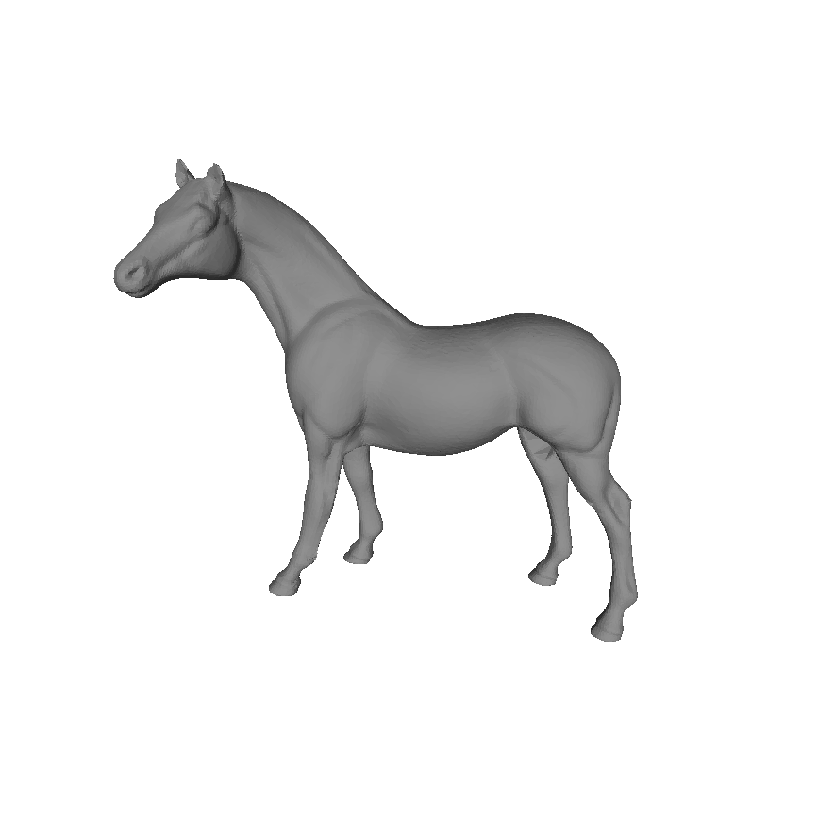
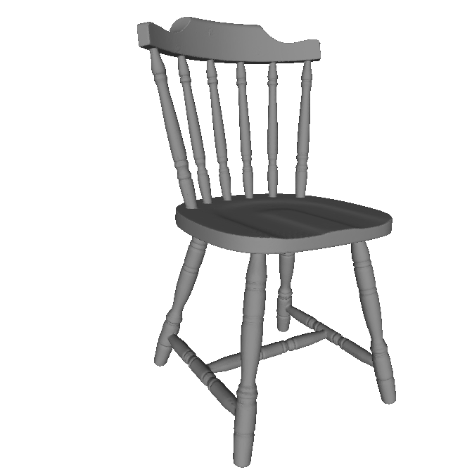
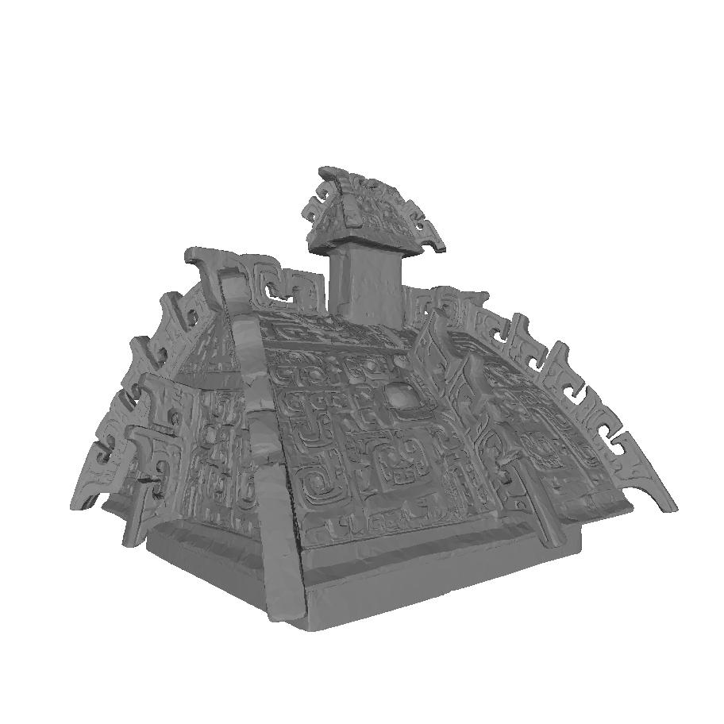
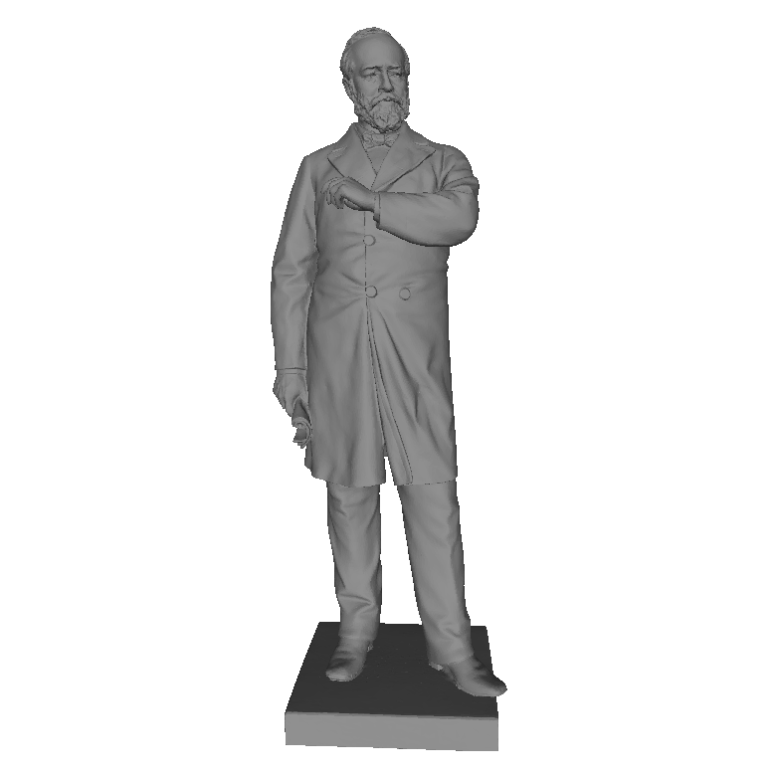
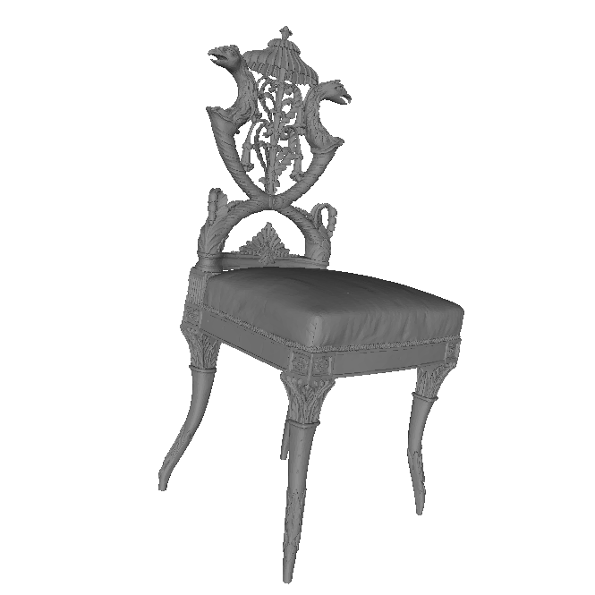
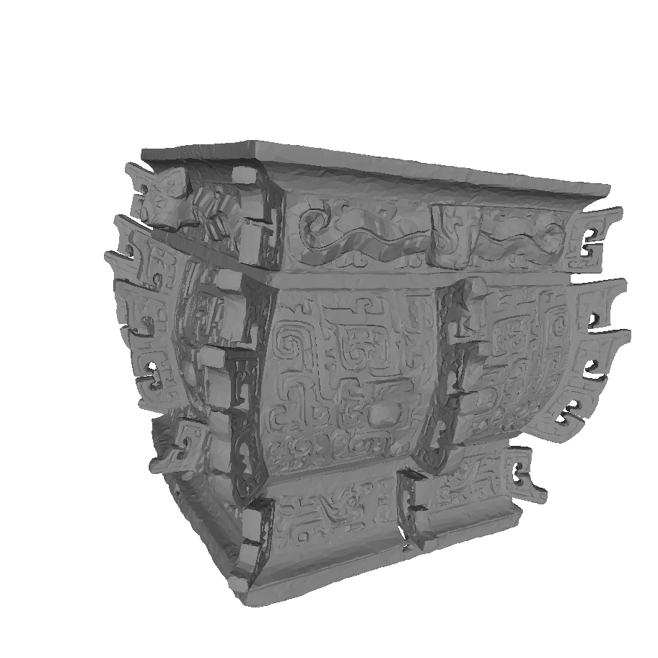
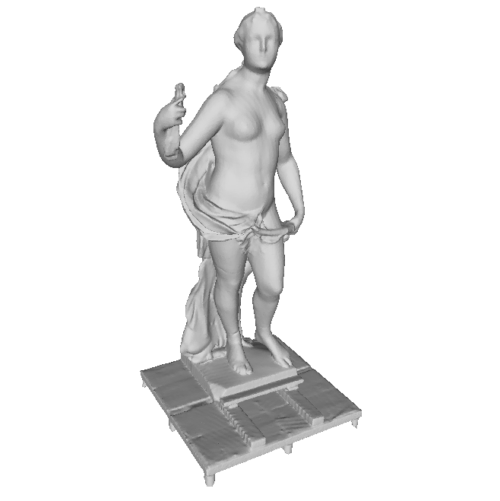
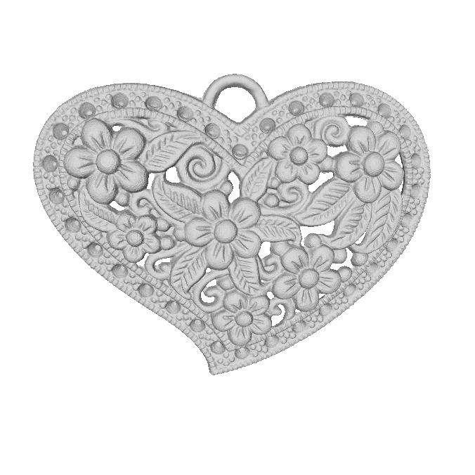
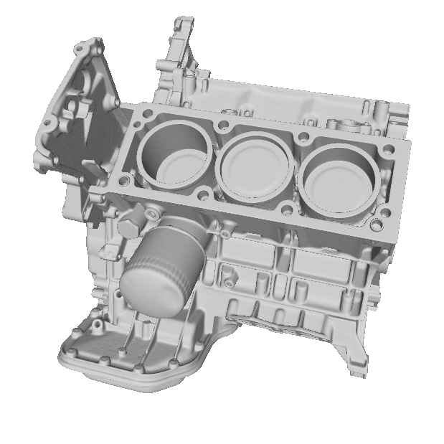
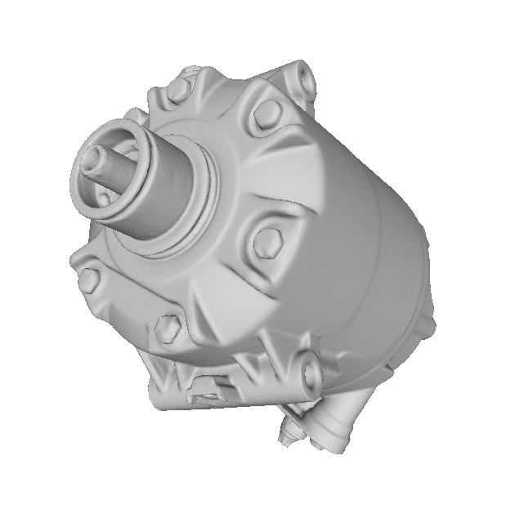
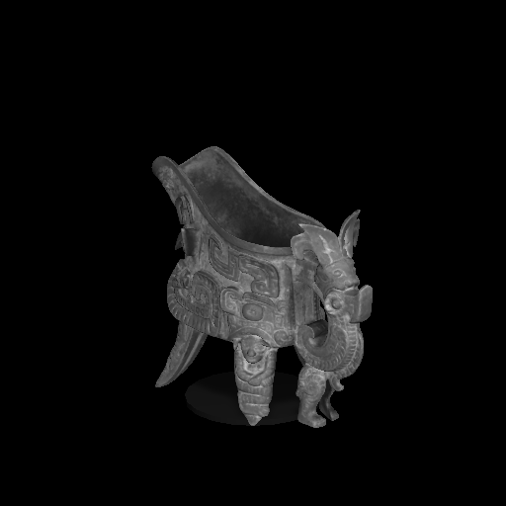
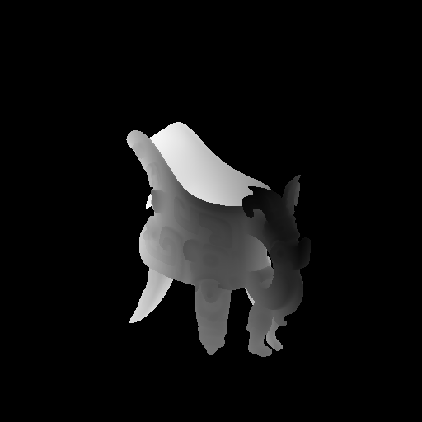
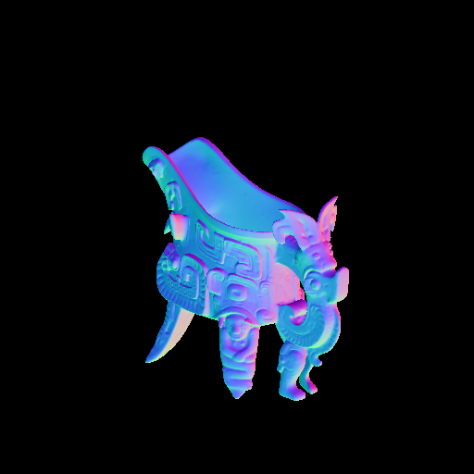








Improved Surface Normal Inference from Calibrated Illuminated RGB-D images
Jingyuan Sha
Notes:
Hello everyone, welcome to my thesis defense presentation. The title of my thesis is ….
Let me first introduce the task we worked on in this thesis

Slide 2




Task: Surface Normal Inference
Image
Normal Map (semi-dense)
Surface normals of a scene is presented as a normal map
Surface normal is shown in RGB color
We want to find the surface normal map of the corresponding scene.
Notes:
Our task is to estimate the surface normal of a 3D object. We want to calculate the normal of each pixel in the image. This way we can know in which direction it is pointing. The surface normal can be used for surface reconstruction, shading generation, and other visual effects.

Slide 3


Task: Surface Normal Inference
Standard method compute normal from point cloud using neighboring information
Gray-scale or RGB image
Depth Map (semi-dense) , and known calibration
→point cloud or vertex map
Normal Map (semi-dense)
Normal maps are only semi-dense, when mapped to a mesh (dense) it is not good at all.
Errors can occur in regions with reflections, where we have errors in the 3D measurement
Notes:
Traditionally, we can use the depth map as input to convert it into a point cloud and estimate the surface normal using a neighborhood-based approach.
However, in practice, the depth map has many missing pixels and holes, so the neighbors of many points are insufficient for normal estimation.
Moreover, the neighborhood-based approach depends on a well-chosen neighborhood size.

Slide 4



Neighbor-Based Approach: Depends on the neighbor size
K=1
K=2
K=3
Depends on the selected neighborhood size.
If it is too small → noise sensitive.
If it is too big → too smooth and not crispy
Notes:
As shown in these 3 images. If it is too small, as in the first image, it is too sensitive to noise;
if it is too large, as in the right image, the sharp details are lost.
So the neighborhood-based approach depends on a well-chosen neighborhood size.
And ideally, different areas have different optimal neighborhood sizes.

Slide 5


Motivation: Illuminated Calibrated RGB-D Image + Deep Learning
Depth Map (semi-dense)
Normal Map (fully-dense)
Use Deep Learning based approach to estimate the surface normal
Notes:
To mitigate this problem, we use a Deep Learning based approach to estimate the surface normals. Thus, we do not search for an optimal window size, but let the network parameters decide the normal directions.

Slide 6



Motivation: Illuminated Calibrated RGB-D Image + Deep Learning
Light
Illuminated gray-scale image
Depth Map (semi-dense)
Light map (semi-dense)
Illuminate the object by a strongly directed light of the video projector whose position is known.
There are theoretical relationships between light position, normal direction, fundamental color albedo....
It can be assumed that normals, primary color and light change coherently, which should be modeled in the neural network.
Notes:
And moreover, inspired by the photometric stereo,
there are theoretical relationships between the light, the normal, and the albedo of the ground color. We consider using an extra strong directional light to illuminate the object surface, then we use a camera to obtain a fully dense illuminated image, and also, based on the depth map and the known calibration matrix, we can calculate the corresponding light directions of each pixel
So we consider using the illuminated image, depth map and light map to further improve the result of normal estimation.

Slide 7
Motivation: Illuminated Calibrated RGB-D Image + Deep Learning
Light
Illuminated gray-scale image
Depth Map (semi-dense)
Light map (semi-dense)
Normal Map (fully-dense)
Illuminate the object by a strongly directed light of the video projector whose position is known.
There are theoretical relationships between light position, normal direction, fundamental color albedo....
It can be assumed that normals, primary color and light change coherently, which should be modeled in the neural network.
Notes:
And hopefully achieve a better result compared to the neighborhood-based approach.

Slide 8

Overview of Ours
Estimation of the corresponding surface normals
Deep learning based approaches.
Two models have been proposed:
GCNN
Geometry information based approach
Takes depth map as input
Robust to semi-dense inputs
Trip-Net
Approach based on geometry and illumination information
Takes depth map, grayscale image, light map (calibrated illuminated RGB-D images) as input
Robust to semi-dense inputs
10% less error compared to GCNN (resolution 128x128)
Notes:
In our approach, we first developed a CNN network for normal estimation based on gated convolution called GCNN. The network takes a semi-dense depth map as input and outputs a fully dense surface normal map.
Then, we improved the depth map-based approach by developing another network based on the same model but using the illuminated calibrated RGB-D image as input and also estimating the surface normal map.
In our evaluation experiments, we found that the second approach using RGB-D images has better performance than the first approach using only the depth map.

Slide 9


Gated Convolution Neural Network (GCNN)
Designed For:
The input data can be semi-dense, but the output is fully dense.
The output data has a high resolution (or the same as the input data).
The output data preserves the fine details of the input data.
Notes:
So let me introduce the first proposed network GCNN.
It is designed to solve tasks where the input data is semi-dense, but we want the output data to be as dense as possible.
And for the normal inference task, we want the output to have the same resolution as the input, so we have a 1-1 mapping, each normal corresponds to one pixel.

Slide 10

U-Net: existing solution for upsampling task
Paper: Olaf Ronneberger, Philipp Fischer, and Thomas Brox. U-Net: Convolutional Networks for Biomedical Image Segmentation. 2015. arXiv: 1505.04597 [cs.CV].
U-Net Architecture
Fully-Convolution design
Up-sampling for high resolution output
Skip connection guarantees sharpness
Input data is fully dense, not suit for semi-dense input data.
Output resolution smaller than input
Only one type of input
Notes:
Based on these requirements, we found the following existing techniques.
U-Net is a well-designed architecture, initially used in the field of image segmentation. The multiple upsampling operations guarantee high resolution output.
The skip connection provides further sharpness in the output, connecting the high-resolution feature maps from the downsampling part to the upsampling features.
However, the method was developed for processing completely dense input data such as images. In the normal inference task, our input data is only semi-dense, the missing regions cause ambiguity in training and we should reduce the impact of these pixels. Moreover, the output in the original U-Net is smaller than the input resolution, so it cannot guarantee 1:1 mapping.

Slide 11




Gated Convolution Layer (gconv)
Paper: Jiahui Yu et al. Free-Form Image Inpainting with Gated Convolution. 2018
Gate: learn to find a mask from data
$Gating_{\left\{y,x\right\}}=ΣΣ W_{g}⋅I$
$Feature_{\left\{y,x\right\}}=ΣΣ{ W}_{f}⋅I$
$O_{\left\{y,x\right\}}=φ\left(Feature_{\left\{y,x\right\}}\right)⊙σ\left(Gating_{\left\{y,x\right\}}\right)$
$φ:leakyReLU$
$σ:Sigmoid$
Notes:
To solve the problem of semi-dense input, we use gated convolution layer to replace standard convolution.
In gated convolution layer, we make a dual layer design, one of the layers extracts the feature map with LeakyReLU activation function, this is exactly the same as standard convolution layer design. The difference is that we use another layer as a gating layer to estimate the confidence of each pixel, using a sigmoid activation function. The output is the element-wise product of gating and features.

Slide 12

Proposed Network: GCNN
Down-sampling
Up-sampling
Architecture:
3 gated conv Layers
3 times down-sampling (gated conv layers)
3 times up-sampling (gated conv layers)
2 conv2d layers (standard conv layers)
Properties:
Designed for geometry based approach
Input: Vertex Map
Output: Normal Map
Notes:
Based on U-Net and gated convolution, we have developed a network, the gated convolution neural network, or GCNN.
The cyan color indicates the gated convolution layer.
In each gated convolution, we padded the margin to maintain the resolution of the last layer
We use a convolution with step size 2 to down-sample the feature maps.
We repeat this 3 times.
For upsampling, the feature map is first interpolated to double the size of the feature map,
Then the high-resolution feature map is concatenated in the down-sampling part using Skip Connection,
This is followed by another gated convolution layer to reduce the channel size.
The upsampling is repeated three times so that the output has the same resolution as the input.
In the last step, two standard convolutional layers were added to predict the normal map.
So this is the network that takes the depth map as input and estimates the normal map. Note, that the input is only semi-dense.

Slide 13



Consider illuminated information
Vertex map
Light map
Network requirement:
Can handle 3 types of input data, each type of data has different channels
Can handle semi dense inputs
The output is a normal map with 3 channels
Image
Notes:
GCNN is a basic architecture that can take one kind of data as input, such as vertex map.
Since we also want to consider the illuminated information, such as the image map and light map. So we need to design a network that accepts a total of 3 types of data as input and also find a way to integrate these feature maps.

Slide 14
Trip-Net
Side-Pipe
Main-Pipe
Normal Map
Side-Pipe
Notes:
Based on the GCNN architecture, we developed our proposed Trip-Net network, which uses image, vertex map, and light map together as input for surface normal inference.
This network has three pipes, where each pipe has its own input. The output is the corresponding normal map.
In the upsampling part, we use 4 fusions to integrate the feature map from the side pipes into the main pipe. So, during the upsampling, the network considers different branches for estimating the surface normals.

Slide 15
Dataset
Training
50 point clouds
5 point clouds
Test
Notes:
To train our network, we created a dataset with 55 3D objects. We searched them on the Internet and used 50 for training and 5 for testing. To get a reliable ground-truth, we generate the dataset with the 3D game engine Unity.

Slide 16





Image
Depth Map
Normal Map
Camera Preview
Object
Light
Unity Scene
Depth Camera
Notes:
We create the synthetic scenes using Unity to capture the RGB-D images. First, we place a calibrated depth camera whose intrinsic and extrinsic matrix is known. Then we place a strong directional light nearby whose position is also known. The object is placed on a small stage where the light can properly illuminate the surface and the camera can capture the corresponding scene.
We capture a grayscale image, a depth map, and the normal map for each scene. All the data is fully compacted. So we have both the geometry and the lighting information.

Slide 17

Adding Noise
Notes:
To simulate the noise, we applied a random drop-off noise to our depth map. The intensity of the noise is controlled by a parameter mu, which specifies the percentage of the noise. The range of mu is randomly chosen between 0 and 50 for each scene.

Slide 18










Recorded Data
Image
Normal
Depth
Noised Depth
For the same object, we record the scenes from a number of random directions
Random light position
Random position and orientation of the object
Notes:
During data collection, we capture the data from different directions by randomly changing the light position, object position and orientation. This allows us to create many more different scenes with the same objects.
The data we recorded in each scene is shown in the left table.

Slide 19



Dataset
Synthetic Dataset
Real Dataset
Simulated by Unity
Image resolution: 128x128
50 training objects
5 test objects
3000 training scenes
100 test scenes
Detected with a light scanner
Image resolution: 512x512
4 training objects
1 test objects
320 training scenes
80 test scenes
Notes:
We prepared two datasets for training. The synthetic dataset was generated by Unity. We also have a real dataset that was taken with a light scanner in the lab.
Both datasets have the same configuration and data type.
We trained our models on different datasets and observe the estimated normal accuracy.

Slide 20



Evaluation Metrics
Average angle error
Median angle error
Degree Percentage Evaluation
5
11.5
22.5
30
Notes:
We use multiple metrics for quantitative evaluation.

Slide 21

GCNN Evaluation
Model | Gated Convolution | Skip Connection
CNN
NOC
GCNN
Use geometry information only (depth map/point cloud).
GCNN: gated convolution layer with skip connection
NOC: gated convolution layer without skip connection
CNN: standard convolution layer with skip connection
Notes:
First, we evaluated GCNN models.
For comparison, we trained a model without gated convolution and a model without skip connection.
All models take a vertex map as input.

Slide 22
Evaluation Metrics
Notes:
There are multiple metrics for quantitative evaluation.
We use average and mean metrics to evaluate the scale of errors.
We use degree error metrics to evaluate the percentage of the accuracy.

Slide 23
Resolution: 128x128
GCNN evaluation
14.54
11.23
13.34
9.08
10.42
6.68
Model | Average | Percent
CNN | 14.54 | -
NOC | 13.34 | 8.25%
GCNN | 10.42 | 28.34%
Model | Average | Percent
CNN | 11.23 | -
NOC | 9.08 | 19,15%
GCNN | 6.68 | 40.52%
Notes:
The result is shown here, with the average angular error on the left and the mean angular error on the right.
The green lines are the GCNN model, the orange lines are the NOC model, i.e. without skip connection, and the red lines are the CNN models, with skip connection but without gated convolution layer.
The GCNN model has a lower angular error in both metrics compared to the CNN and NOC models.

Slide 24
Resolution: 128x128
70.47%
39.98%
59.96%
29.63%
51.65%
16.40%
93.53%
88.87%
89.53%
82.77%
90.14%
82.31%
Notes:
There are four other metrics that evaluate the accuracy of the normal map. For example, 5-degree accuracy means the percentage of pixels that have an error of less than 5 degrees. We evaluate it for 5, 11.5, 22.5 and 30 degrees separately.
For all metrics, we can see that the GCNN performs better compared to the other two models.

Slide 25










Object: Dragon
Resolution: 128x128
GT
CNN
NOC
GCNN
$$0^{°}$$
$${90}^{°}$$
Notes:
For the visual evaluation, we show the estimated normal maps in the first row and the corresponding errors in the second row.
As we can see, the CNN model has the worst result, neither smooth areas like the body nor the detailed areas like the head and tail perform well. The NOC model is much blurrier and has a similar degree of error as the CNN model.
The GCNN model provides much sharper details and higher accuracy.

Slide 26








Object: Dragon
Resolution: 128x128
128 CNN Feature Maps
Size: 32x32
(and more …)
(and more …)
Detail Feature Maps
Global Feature Maps
Value: 0
1
Notes:
We also further compare the three models in a feature map layer. And we observed some interesting behaviors.
First, let's look at the CNN feature maps. We divided them into two groups, the detail feature maps and the global feature maps.
On the left side, these feature maps have a higher value for the detail part of the object. Like the head, the tail and the back legs. On the other hand, the feature maps on the right side have a higher value for almost all areas of the object.
So we suspect that the model uses the left group of feature maps for learning detail features and the right group of feature maps for learning global features.
The interesting thing is that the global feature map is usually incomplete, some lose the tail, some lose the front leg.
And each detail feature map corresponds to too many detail areas. So the same feature map is used to extract multiple detail areas.

Slide 27








Object: Dragon
Resolution: 128x128
128 NOC Feature Maps
Size: 32x32
(and more …)
(and more …)
Detail Feature Maps
Global Feature Maps
Value: 0
1
Notes:
In the NOC model, the result is different after using gated convolution. We can see that the detail feature maps have less bright areas, which means that each detail feature map corresponds to fewer areas in the object. So it is more focused and concentrated on the detail features. Accordingly, the global feature maps are more complete.

Slide 28








Object: Dragon
Resolution: 128x128
128 GCNN Feature Maps
Size: 32x32
(and more …)
(and more …)
Detail Feature Maps
Global Feature Maps
Value: 0
1
Notes:
For the GCNN model, the result is much clearer after adding the skip connection. The detailed feature maps have less bright areas and provide much brighter features, while the global feature maps are much more complete and the brightness is more evenly.

Slide 29

Object: Dragon
Resolution: 128x128
128 CNN Feature Maps
Size: 32x32
Value: 0
1
Notes:
These are all 128 feature maps in the first upsampling part of the CNN model.

Slide 30

Object: Dragon
Resolution: 128x128
128 NOC Feature Maps
Size: 32x32
Value: 0
1
Notes:
These are the feature maps for the NOC model.

Slide 31

Object: Dragon
Resolution: 128x128
128 GCNN Feature Maps
Size: 32x32
Value: 0
1
Notes:
These are the feature maps for the GCNN model.

Slide 32
Trip-Net Evaluation
Model | Geometry Information | Illuminated Inoformation
GCNN
Trip-Net
Notes:
We further evaluate the trip-net approach and use the GCNN as a comparison.

Slide 33
Trip-Net Evaluation
10.42
6.68
9.35
5.89
Model | Average | Percent
GCNN | 10.42 | -
Trip-Net | 9.35 | 10.27%
Model | Average | Percent
GCNN | 6.68 | -
Trip-Net | 5.89 | 11.83%
Notes:
The left line is the average angular error and the right line is the mean angular error.
The Trip-Net is shown in the green line, while the GCNN model is shown in the yellow line.
As we can see, after using the illumination information, the Trip-Net improves the error by up to 10% on average compared to the GCNN model that uses only geometry information.

Slide 34
74.50%
44.75%
70.47%
39.78%
94.81%
90.88%
93.53%
88.85%
Notes:
We also evaluate the two models using different accuracy metrics. And the Trip network achieves much higher accuracy compared to GCNN. The difference is especially large in the small degree metrics.

Slide 35





Object: Dragon
Resolution: 128x128
GT
GCNN
Trip-Net
Error: $9^{°}$
Error: $6^{°}$
$$0^{°}$$
$${90}^{°}$$
Notes:
In the visual evaluation, we can see that Trip-Net provides much more sharp details. The scale of the dragon is very clear and the details in the head area are sharper and more accurate.

Slide 36

Training&Evaluation on Higher Resolution (512x512)
Notes:
We also trained our model on a higher resolution dataset (512x512). In this case, all approaches achieve much higher accuracies and the Trip-Net still performs better than the neighborhood-based approach SVD and the GCNN approach.

Slide 37






Object: Dragon
Resolution: 512x512
GT
GCNN
Trip-Net
Error: $9^{°}$
Error: $6^{°}$
$$0^{°}$$
$${90}^{°}$$
Notes:
Visual assessment shows that they can provide a very accurate normal estimate.

Slide 38





Training&Evaluation on Real Dataset
(512x512)
Notes:
We also trained our model on a real data set and made the comparison.

Slide 39






Reference
SVD
Trip-Net
Object: Dragon
Resolution: 512x512
$$0^{°}$$
$${90}^{°}$$
Notes:
In the visual evaluation, we can see that both approaches perform well. Since we do not have the ground truth in the real dataset, we calculate the surface normals based on a different approach and consider it as a reference.
Note that now we have not estimated the surface normals of the missing pixels and only compare the valid pixels.

Slide 40

SVD
Trip-Net
K=2
K=3
Notes:
When we consider the missing pixels together, the visual evaluation is shown here.
Compared to the SVD-based approach, our model does not require a window size, but provides much sharper details and is more robust to noise.

Slide 41

Conclusion
Gated Convolution Neural Network (GCNN)
Handling of semi-dense input data
High resolution output matrix (same as input)
Fine details are preserved
Tiple Pipe Network (Trip-Net)
Extends the geometry-based approach to illuminated, calibrated RGB-D image based approach
Improves accuracy of normal inference by up to 10.4% in average angular error metric compared to GCNN-based approach (resolution: 128x128)
Image
Vertex
GT
GCNN
Trip-Net
Notes:
In conclusion, we have proposed two convolutional networks for surface normal estimation in this paper. The first network called GCNN, which takes the semi-dense vertex map as input and estimates the fully dense normal map as output.
The second network is based on the first network and also considers the lighting conditions and the illuminated images for normal estimation, and we only consider one additional illuminated image. Compared to the GCNN approach, it achieves 10% higher accuracy at 128x128 resolution. It is also robust to semi-dense inputs and provides much sharper details.

Slide 42
Thank you!
Notes:
That‘s all, thank you!

Slide 43

Recall: Surface Normal at point P
Surface Normal
Tangent plane
Properties:
Unit Vector in 3D space
Perpendiculer to the tangent plane at point p
Direction point outward of the object surface
Surface Point P
Surface
Image Source: https://upload.wikimedia.org/wikipedia/commons/7/7e/Surface_normal_illustration.png

Slide 44

Improved Normal Inference from Calibrated illuminated RGB-D images
Photometric Stereo
…
Image 01
Image 02
Image …
Normal Map
Assume Lambert surface
Requires multiple lights for good estimatioin
Solved using least squares method
$$I={(L}_{0}ρ⊙N)⋅(L)$$

Slide 45



Surface Normal Estimation
Surface normals of a scene is presented as a normal map
One Surface normal is mapped to a RGB color
We want to find the surface normal map of the corresponding scene.
Grayscale Image
Point cloud
Normal Map
Viewing of 3D object from a direction
The points are in 3D space
Each point corresponds a pixel in the gray-scale image
Map normal in 3D space to RGB color

Slide 46

Surface Normal Estimation
(Geometry-based Approach)
Surface Normal
Tangent plane
Point Cloud
Normal Map
Surface
Drawbacks:
Normal Map are only semi-dense
Depends on chosen neighbor size,
if it is too small → noise sensitive,
If too large → too smooth and not crispy
Assume neighbors of each point are on the same plane, then construct the tangent plane based on these points
The normal of the tangent plane is the approximation of corresponding surface normal
Image Source: https://upload.wikimedia.org/wikipedia/commons/7/7e/Surface_normal_illustration.png
Notes:
For each point, we assume its neighbors within some distance are on the same plane, then we can uses these points to consctruct a plane. The normal of the plane is approximately the surface normal at this point.
We do this point-wisely to get the final normal map.
Drawbacks:
Normal map is only Semi-dense if mapped on mesh (dense), that is not good at all

Slide 47




Geometry-based Approach
Input
Output
Neighbor information
K,R,t
3D Object
Depth Map
Point cloud
Normal Map
Optimization based
Normal Map are only semi-dense, if mapped on mesh (dense), that is not good at all
Depends on chosen neighbor size, if it is too small → noise sensitive, If too large → too smooth and not crispy

Slide 48

Traditional Approches
1
Geometry based Approach
Depth Map
Point cloud
Normal Map
2
Photometric Stereo
3D Object
…
Image 01
Image 02
Image …
Normal Map

Slide 49


Point Cloud
Grayscale image

Slide 50




Gated Normal Neural Network (GNNN)
Gated Convolution
Learn to find a mask from data
$Gating_{\left\{y,x\right\}}=ΣΣ W_{g}⋅I$
$Feature_{\left\{y,x\right\}}=ΣΣ{ W}_{g}⋅I$
$O_{\left\{y,x\right\}}=φ\left(Feature_{\left\{y,x\right\}}\right) ∗σ\left(Gating_{\left\{y,x\right\}}\right)$
$φ:leakyReLU$, $σ:Sigmoid$
Add Lambertian Reflection constrain to calculate albedo
$ρ=\frac{I}{N∗L}$
$I$are known beforehand, predict $N$ and $L$
$minimize || (\hat{N}∗\hat{L}) −\left(N∗L\right)|{\left.​\right|}_{2}$
Down-sampling
Up-sampling
Notes:
Skip connections: Propagate detailed color or texture information to the decoder of that region

Slide 51




SVD visual evaluation
Fully dense Input
GT
SVD
Error
K=1
0
90
Notes:
Fully dense input, good result, the window size is already the smallest, but the detail is still missing.

Slide 52



SVD visual evaluation
Semi-dense Input
GT
SVD
K=2
Error
0
90
Notes:
For the semi-dense input, the result goes worse, even the smooth area(skin) is not accurate.

